Slide 1

CSE488: Big Data Analytics
Lecture 3:
MapReduce Programming Model
Dr. Mohammad Rezwanul Huq
Associate Professor
East West University

Slide 2
MapReduce is a style of programming designed for:
  Easy parallel programming
  Invisible management of hardware and software failures
  Easy management of very-large-scale data
It has several implementations, including Hadoop, Spark (used in this class), Flink, and the original Google implementation just called “MapReduce”

Slide 3

3 steps of MapReduce
Map:
  Apply a user-written Map function to each input element
    Mapper applies the Map function to a single element
      Many mappers grouped in a Map task (the unit of parallelism)
  The output of the Map function is a set of 0, 1, or more
key-value pairs.
Group by key: Sort and shuffle
  System sorts all the key-value pairs by key, and outputs key-(list of values) pairs
Reduce:
  User-written Reduce function is applied to each key-(list of values)
Outline stays the same, Map and Reduce change to fit the problem

Slide 4

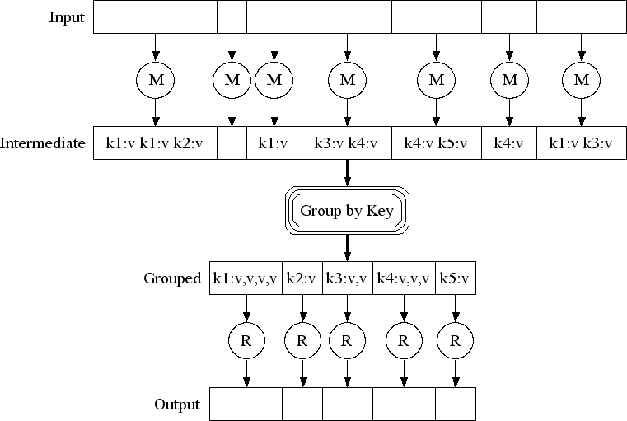
MAP:
Read input and produces a set of key-value pairs
Group by key:
Collect all pairs with same key
(Hash merge, Shuffle, Sort, Partition)
Reduce:
Collect all values belonging to the key and output

Slide 5
MapReduce: Formal Representation
Input: a set of key-value pairs
Programmer specifies two methods:
  Map (k, v) → <k’, v’>*
    Takes a key-value pair and outputs a set of key-value pairs
    There is one Map call for every (k, v) pair
  Reduce (k’, <v’>*) → <k’, v’’>*
    All values v’ with the same key k’ are reduced together
    There is one Reduce function call per unique k’

Slide 6

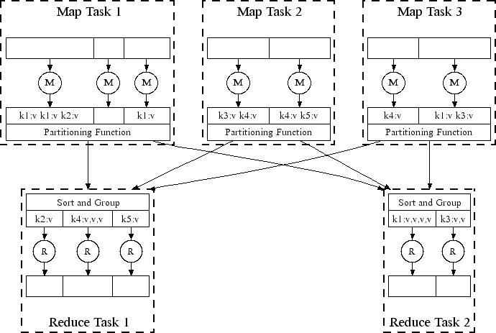
All phases are distributed with many tasks doing the work

Slide 7

key-value pairs
Input
Output
Mappers
Reducers

Slide 8
Example MapReduce task:
We have a huge text document
Count the number of times each distinct word appears in the file
Many applications of this:
  Analyze web server logs to find popular URLs
  Statistical machine translation:
    Need to count number of times every 5-word sequence occurs in a large corpus of documents

Slide 9




Provided by the programmer
Provided by the programmer
MAP:
Read input and produces a set of key-value pairs
Group by key:
Collect all pairs with same key
Reduce:
Collect all values belonging to the key and output
OSnelqyuesnetiqaulleynrteiaald trheeaddas ta
The crew of the space shuttle Endeavor recently returned to Earth as
ambassadors, harbingers of a new era of space exploration. Scientists at
NASA are saying that the recent assembly of the Dextre bot is the first step in
a long-term space-based man/mache partnership. '"The work we're doing now -- the robotics we're doing - - is what we're going to need ……………………..
(The, 1) (crew, 1)
(of, 1) (the, 1)
(space, 1) (shuttle, 1)
(Endeavor, 1) (recently, 1) ….
(crew, 1) (crew, 1) (space, 1)
(the, 1) (the, 1) (the, 1)
(shuttle, 1) (recently, 1) …
(crew, 2)
(space, 1)
(the, 3)
(shuttle, 1)
(recently, 1)
…
Big document
(key, value)
(key, value)
(key, value)

Slide 10
map(key, value):
# key: document name; value: text of the document for each word w in value:
emit(w, 1)
reduce(key, values):
# key: a word; value: an iterator over counts
result = 0
for each count v in values: result += v
emit(key, result)

Slide 11
MapReduce environment takes care of:
Partitioning the input data
Scheduling the program’s execution across a set of machines
Performing the group by key step
  In practice this is is the bottleneck
Handling machine failures
Managing required inter-machine
communication

Slide 12

Map worker failure
  Map tasks completed or in-progress at worker are reset to idle and rescheduled
  Reduce workers are notified when map task is rescheduled on another worker
Reduce worker failure
  Only in-progress tasks are reset to idle and the reduce task is restarted

Slide 13
Application Areas
Server log analysis
  Finding popular URLs
Information Retrieval System
  Calculating term frequency
Language Model
  Calculating n-gram
Statistical Computation
  Calculating mean, variance, max, min etc.

Slide 14
Refinements: Combiners (1)
Often a Map task will produce many pairs of the following form
(k, v1), (k, v2), … for the same key
  Popular words in the word count example
It is possible to save network time by pre-aggregating values in the mapper.
  Combine (k, list(v1)) → (k, v1’)
  Combiner is usually the same as the reduce function

Slide 15
Refinements: Combiners (2)
Combiner trick works only if reduce function is commutative and associative.
Example: Sum function

Slide 16
Refinements: Combiners (3)
How about average function?

Slide 17
Refinements: Partition Function (1)
Want to control how keys get partitioned
  The set of keys that go to a single reducer worker
Hadoop uses a default partition function
  Hash(key) mod R
Sometimes useful to override the hash function

Slide 18
Refinements: Partition Function (2)
Consider the following dataset
Find maximum score for both male and female groups.
First, write a map function that generates male/female as the key and the score as the value.
Name | Age | Gender | Score
Alice | 23 | Female | 45
Bob | 53 | Male | 89
Chris | 76 | Male | 67
Dona | 38 | Female | 53
Elton | 25 | Male | 27
Fiona | 27 | Female | 99

Slide 19
Refinements: Partition Function (3)
public class CustomPartitioner extends
Partitioner<Text, Text>
{
public static int getPartition(Text key, Text value,
int numReduceTasks){
if(numReduceTasks==0) { return 0; }
if(key.equals(new Text(“Male”)) { return 0; }
else { return 1; }
}
}
Set the number of reduce tasks by using job.setNumReduceTasks(int)

Slide 20
Partitioner in MRJob
Built-in Hadoop partitioners you can use:
Partitioner | Description
HashPartitioner | Default, uses hash of key
TotalOrderPartitioner | Guarantees globally sorted output
KeyFieldBasedPartitioner | Partition by specific fields in key

Slide 21
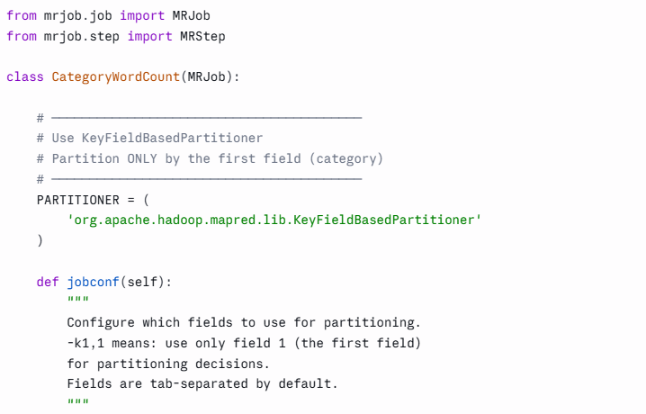
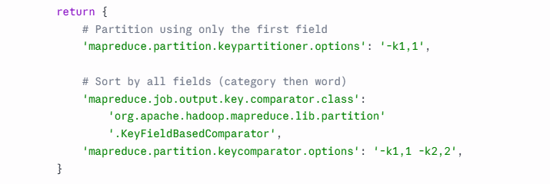
Example: Partitioner in MRJob

Slide 22
Implementations
Google MapReduce
  Uses Google File System (GFS) for stable storage
  Not available outside Google
  Download and read these papers:
  https://drive.google.com/drive/folders/1IhqwBAuun-vJHYHxES7QqblVvfnEyUDj?usp=sharing
Hadoop
  Open source implementation in Java
  Uses HDFS for stable storage
Hive, Pig
  Provide SQL-like abstractions on top of Hadoop MapReduce layer

Slide 23
MapReduce in the Cloud
Ability to rent computing by the hour
  Additional services such as persistent storage
Amazon’s Elastic Compute Cloud (EC2)
  S3 (stable storage)
  Elastic Map Reduce (EMR)

